Slide 1




HOPE TO SKILL
Lecture 37
Splitters and
Embeddings
Artificial Intelligence Advance Course

Slide 2





AI INSTRUCTORS
Dr.Irfan Malik
Dr.Sheraz Naseer
Dr.Shazia Saqib
Ramsha Imran
M.Haris Tariq

Slide 3



Previous Lecture Topics
01
Introduction to RAG
02
Introduction to Langchain
03
Document loading

Slide 4
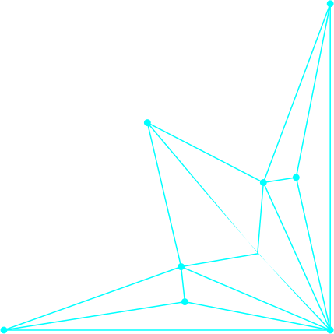

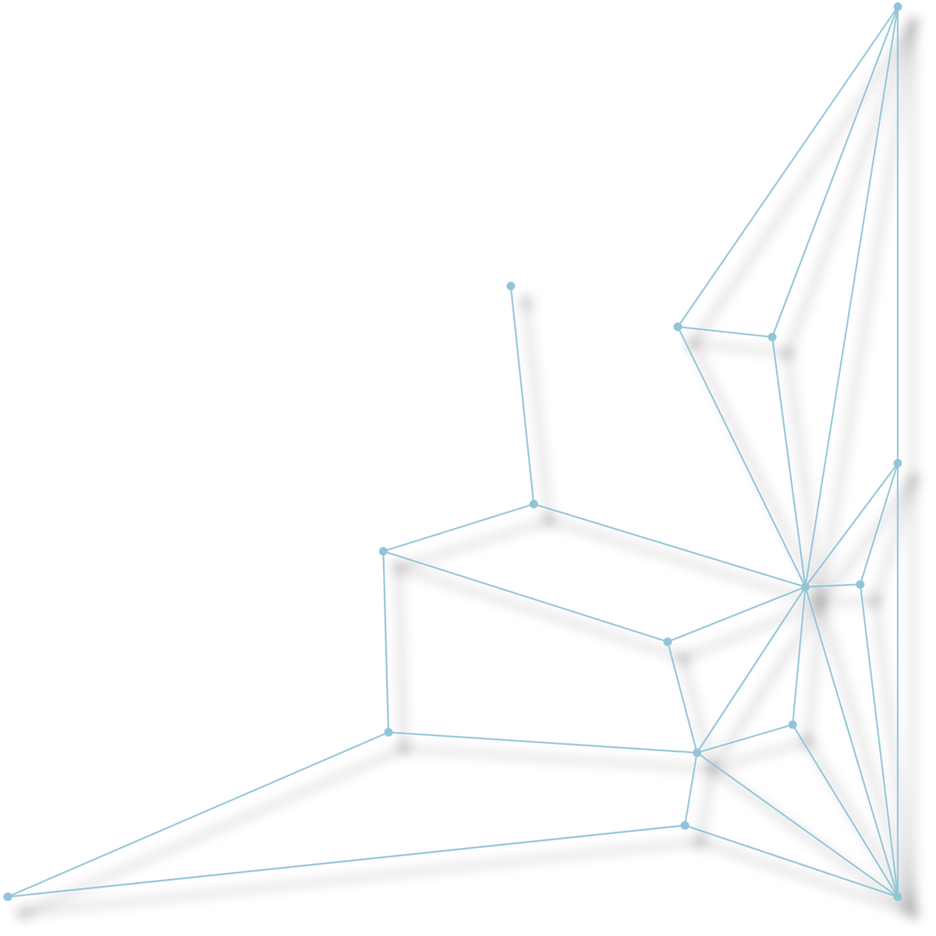
Outline
Splitters in LangChain
Types of splitters
Embeddings

Slide 5
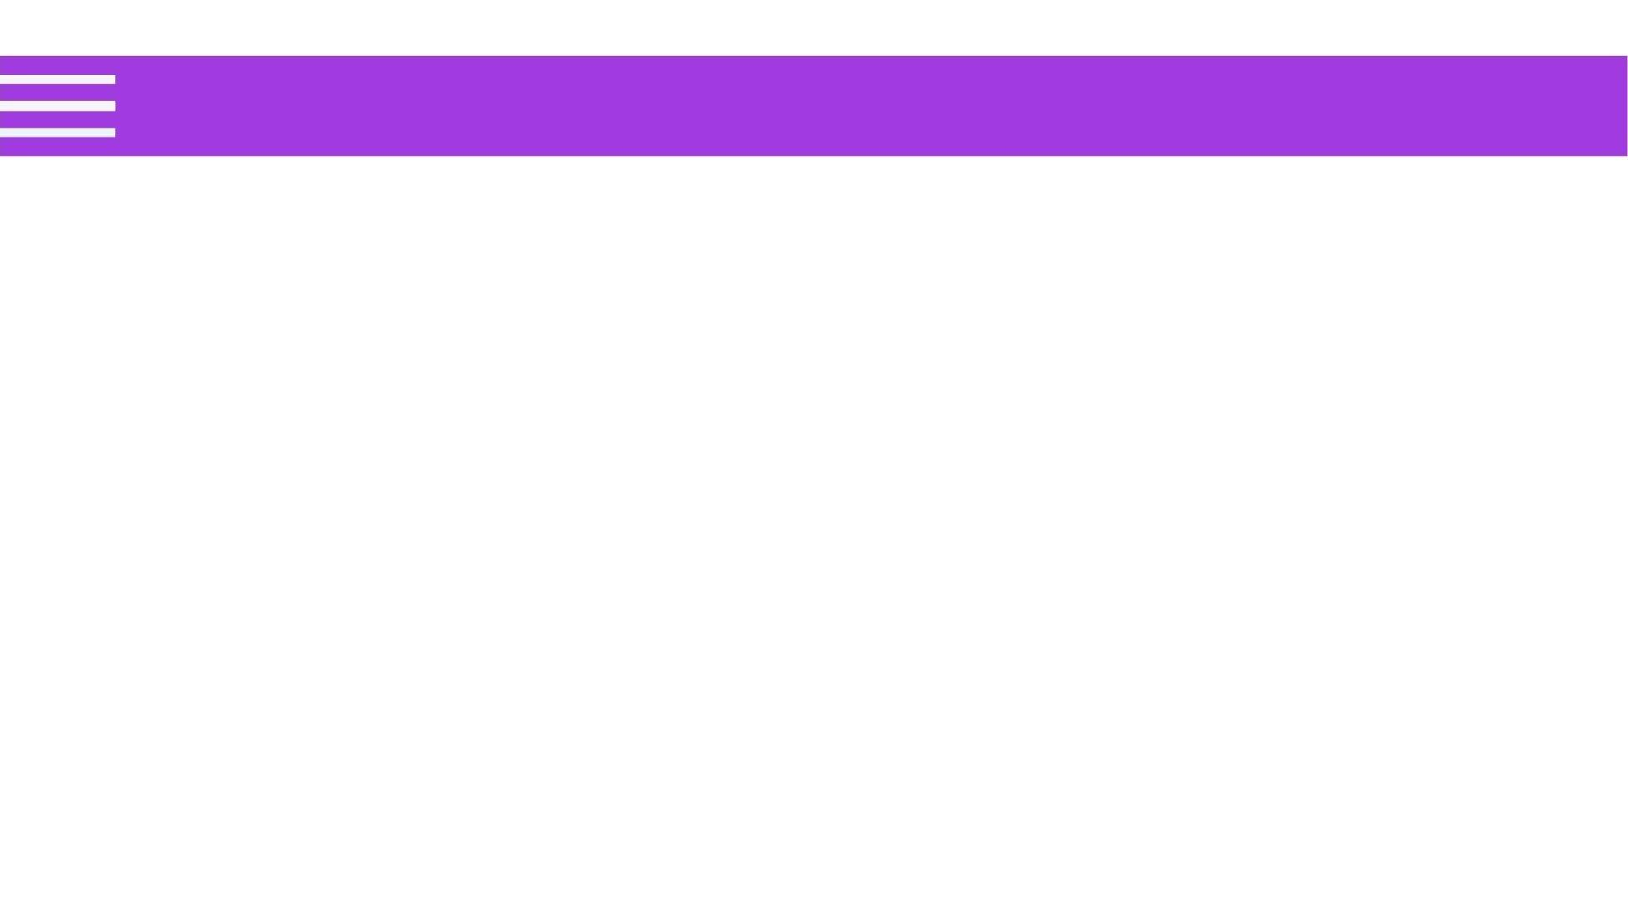

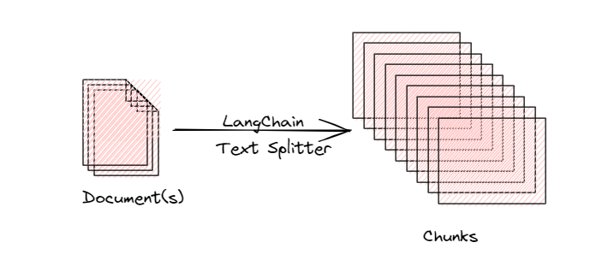

Splitters
Splitters are tools used to divide a large text document into smaller, more manageable chunks.

Slide 6
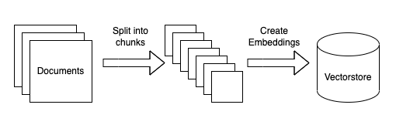
Splitters
These chunks can then be processed individually for various natural language processing (NLP) tasks, ensuring the text remains within the size constraints of the model or system being used.

Slide 7
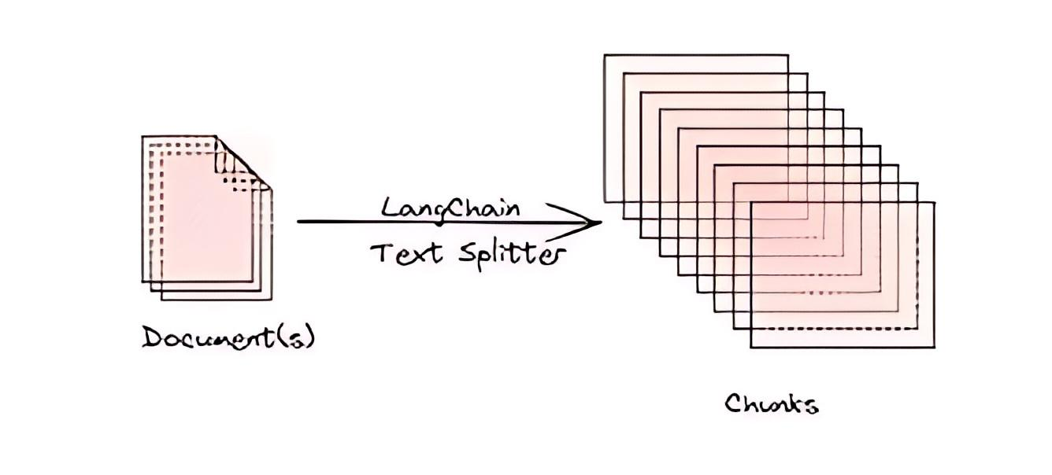
Splitters
Splitters help maintain the context and integrity of the
text, making it easier to handle and analyze.

Slide 8
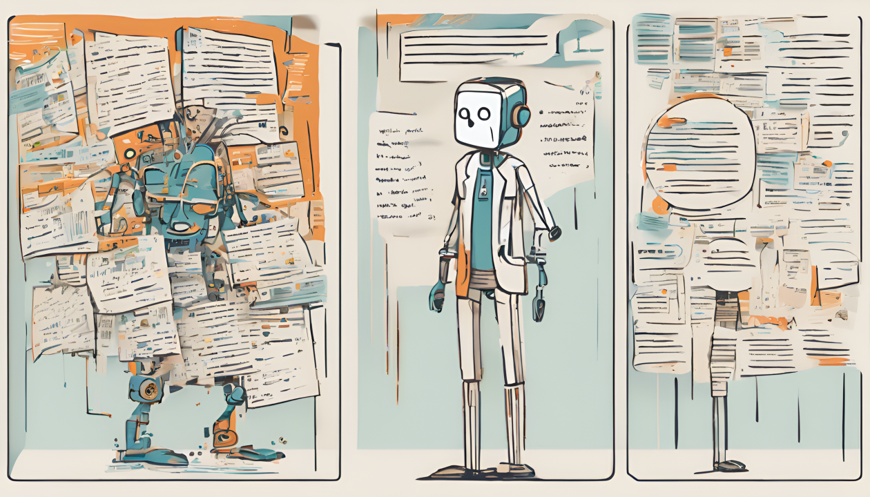
Types of Splitters
Recursive Splitter
HTML Splitter
Markdown Splitter
Code Splitter
Token Splitter
Character Splitter
Semantic Chunker

Slide 9
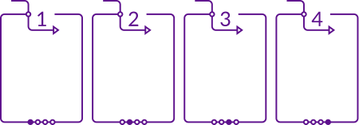
Recursive Splitter
Uses a
hierarchical
approach to
split text.
Attempts to split at larger, natural breakpoints first (e.g., paragraphs).
Recursively processes chunks until they fit size constraints.
Ensures context is preserved as much as possible.

Slide 10
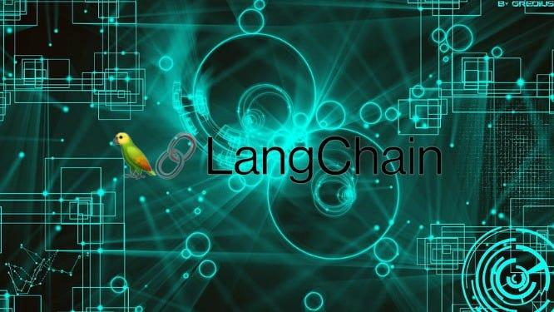
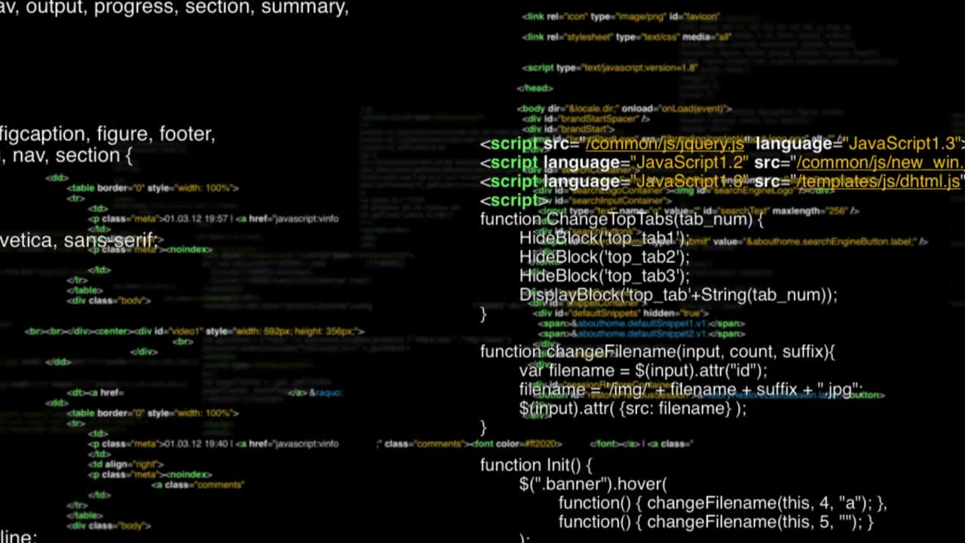
HTML Splitter
Specifically designed to handle HTML content.
Splits text based on HTML tags and structure.
Useful for processing web pages and HTML documents.
Can maintain the integrity of HTML elements.

Slide 11

Markdown Splitter
Handles Markdown formatted text.
Splits text based on Markdown syntax (e.g., headers, lists).
Useful for processing Markdown documents and notes.
Preserves the structure of Markdown elements.

Slide 12
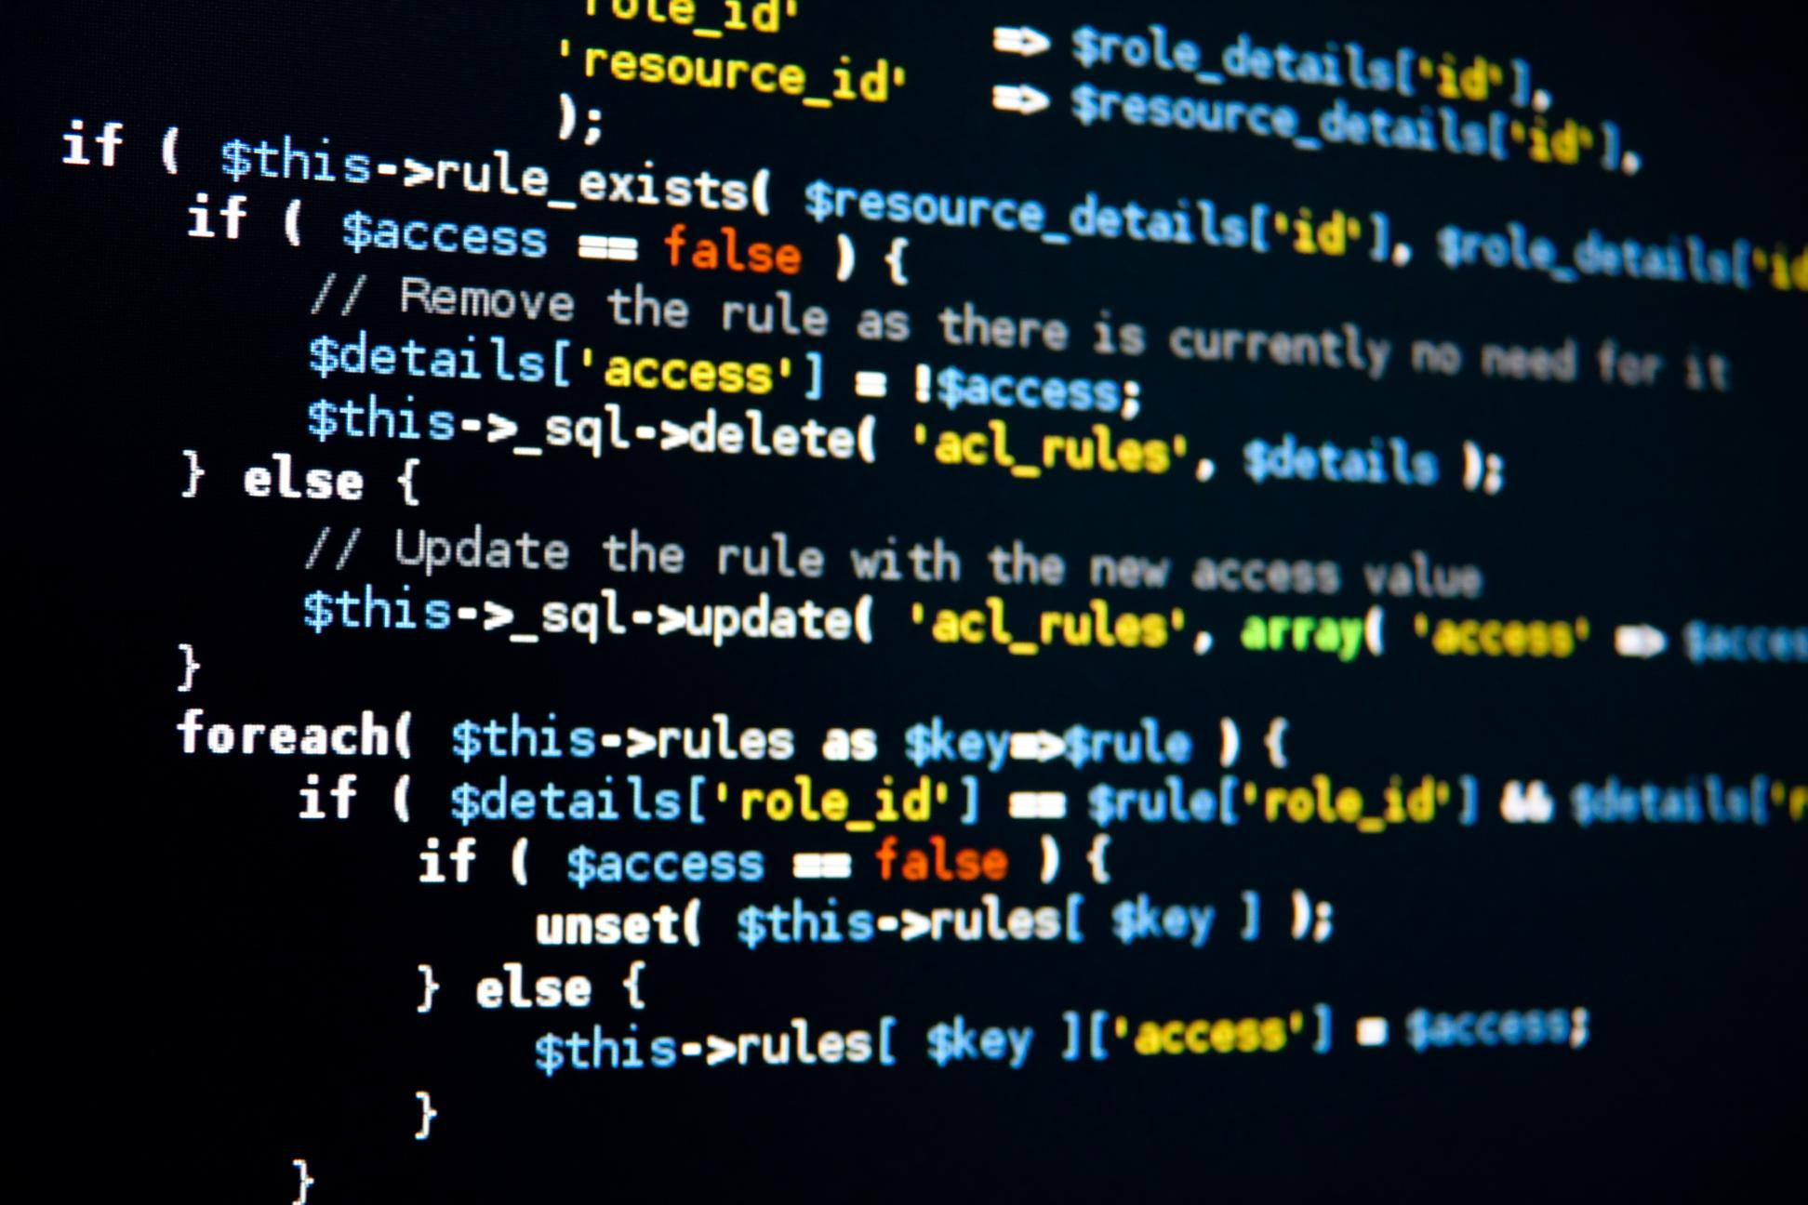
Code Splitter
Designed for splitting source code.
Splits based on code structure (e.g.,
functions, classes).
Maintains the logical integrity of the code.
Useful for processing and analyzing
code snippets.

Slide 13

Token Splitter
Splits text based on tokens (words or subwords).
Ensures each chunk contains a specified number of tokens.
Useful for models with token-based input limits.
Can handle different tokenization schemes.

Slide 14





Character Splitter
Splits text based on character count.
Simple and direct approach to splitting.
Useful when character-based limits
are important.
Can be combined with other splitters for
finer control.

Slide 15


Character Splitter
Splits text based on character count.
Simple and direct approach to splitting.
Useful when character-based limits
are important.
Can be combined with other splitters for
finer control.

Slide 16

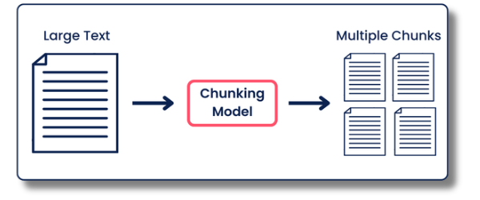
Semantic Chunker
Splits text based on semantic meaning.
First splits on sentences. Then combines ones next
to each other if they are semantically similar enough.
Preserves the meaning and context of each chunk.

Slide 17

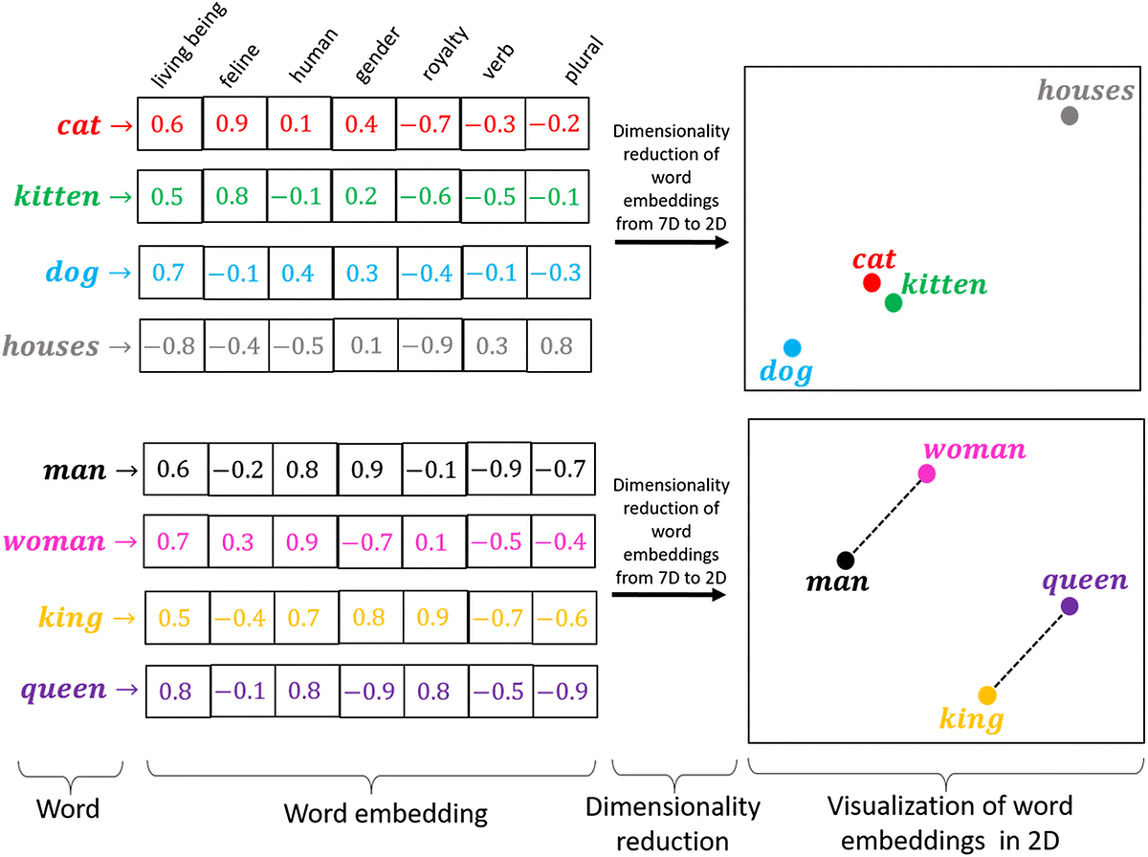
Embeddings
Embeddings are a type of dense vector representation used to capture the semantic meaning of words, phrases, sentences, or other types of data.

Slide 18
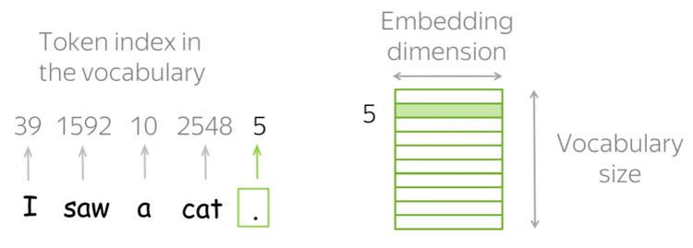
Embeddings
They are widely used in natural language processing (NLP) and other fields of machine learning to transform categorical data into numerical form, which is more suitable for computational models.

Slide 19

Demo

Slide 20






Summary
Splitters in Langchain
Explain Splitters Types
‹#›

